Slide 1

INTRODUCTION TO C PROGRAMMING
BATCH: - 2023 -2024
BCA 1st YEAR
SUBMITTED BY: - ANKUSH SINGHAL,ASHISH CHAUHAN,AYUSH RAWAT
SUBMITTED to: - Mr. rishi Kumar.

Slide 2
Presentation By GROUP R - Insurance Policy System Presented by- ANKUSH SINGHAL,ASHISH CHAUHAN,AYUSH RAWAT

Slide 3


INSURANCE POLICIES SYSTEM
An insurance policy system is a comprehensive system that manages all aspects of insurance policies. Here are some key features:
Record Management: The system acts as the record management system for all insurance policy-related information. This includes records such as quotes, rating actions, issuances, renewals, and more.
Policy Lifecycle Management: The system manages the entire policy lifecycle, including housing and updating policy details, updating new billing information, tracking beneficiary changes, ending policies, designing transaction workflows, and more.
Insurance Repositories (IR): Introduced by IRDAI, the IR system provides policyholders a facility to keep insurance policies in electronic form and to undertake changes, modifications, and revisions in the insurance policy with speed and accuracy.
Policy Administration Solutions: These are designed to manage an insurance company’s entire catalogue of policies on offer and all policies they have issued.
Integration with Other Systems: A policy administration solution spans insurance functions including rating, quoting, case installation, renewal, and servicing, and is integrated into billing and claims platforms.
Reporting: The system can produce policy-specific reports.
There are many insurance policy administration systems available in the market, such as BriteCore, Ventiv Policy, and Oracle Insurance Policy Administration. Each system has its own features and benefits, so it’s important to choose one that best fits the needs of the insurance company.

Slide 4
Life Insurance Policy
A life insurance policy is a contract between an insurance company and a policyholder. The insurer promises to pay a fixed amount of money in return for a premium, after a set period or upon the death of the insured.

Slide 5
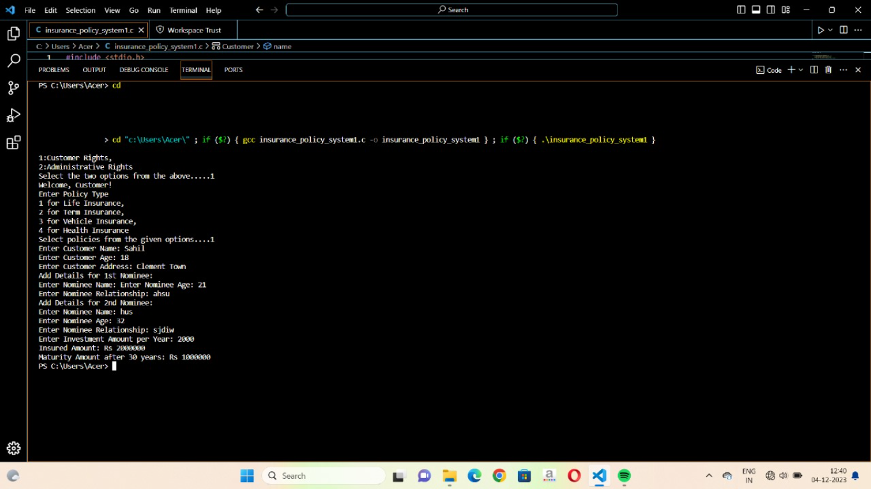

Slide 6
Term Insurance Policy -
Term insurance is a type of life insurance policy that provides coverage for a specific period of time. If the insured person dies during the policy term, a death benefit is paid to the nominees

Slide 7
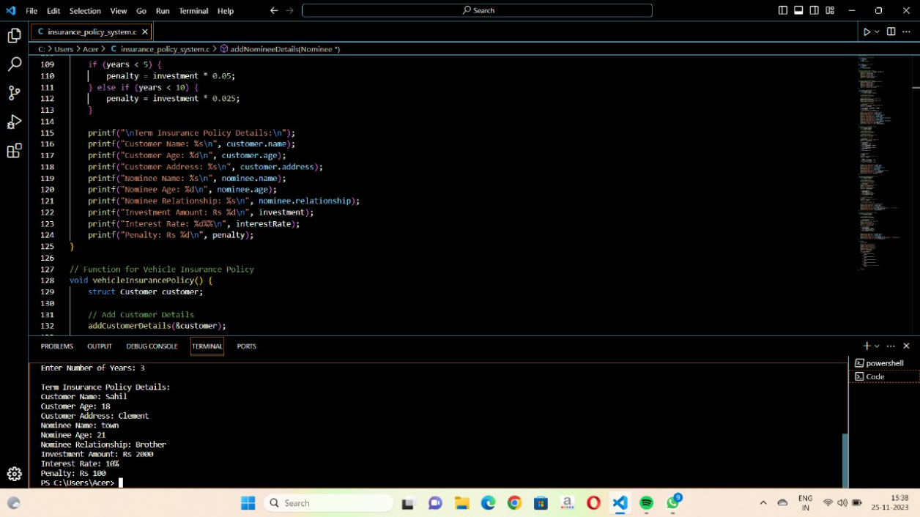

Slide 8
Vehicle Insurance Policy -
A vehicle insurance policy is a mandatory insurance policy designed for vehicles plying on the roads. It provides financial protection to you and your vehicle against any loss or damages resulting from accidents, theft, fire, calamities, and third-party person or property

Slide 9
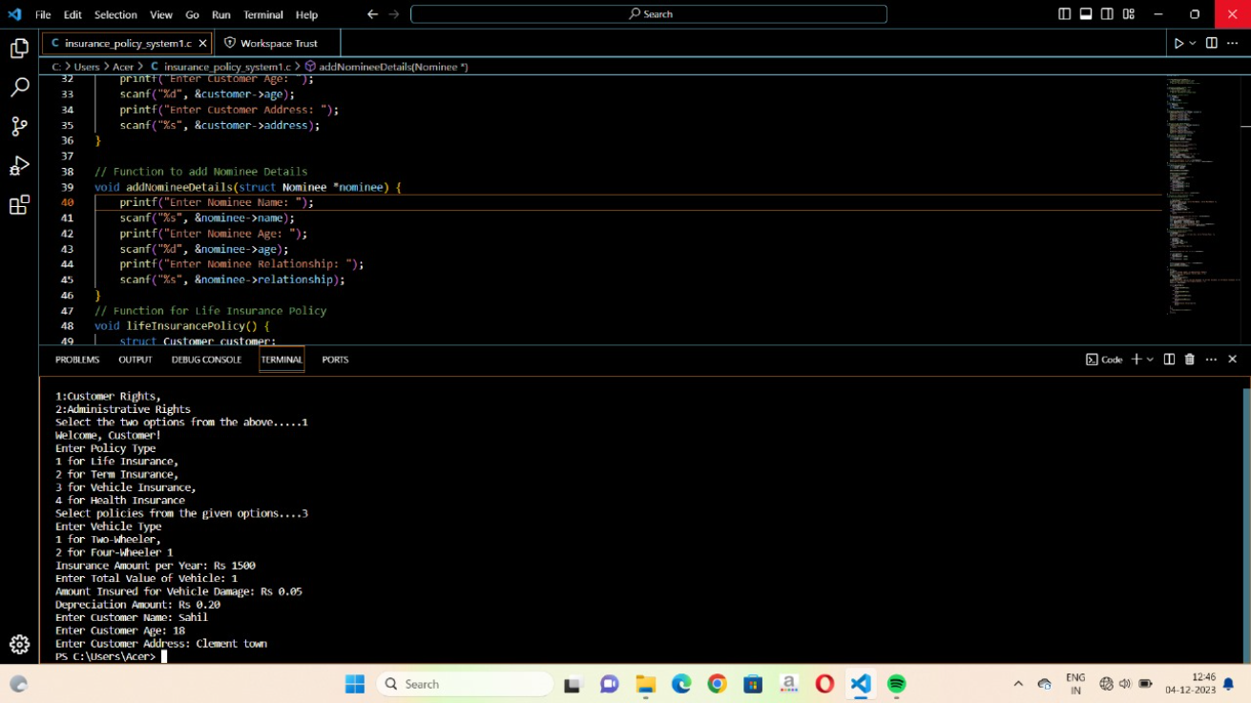

Slide 10
Health Insurance Policy -
A health insurance policy is a contract between an insurer and an individual or group in which the insurer agrees to provide specified health insurance cover at a particular premium. It covers medical expenses incurred due to an illness, accident, or injury.

Slide 11
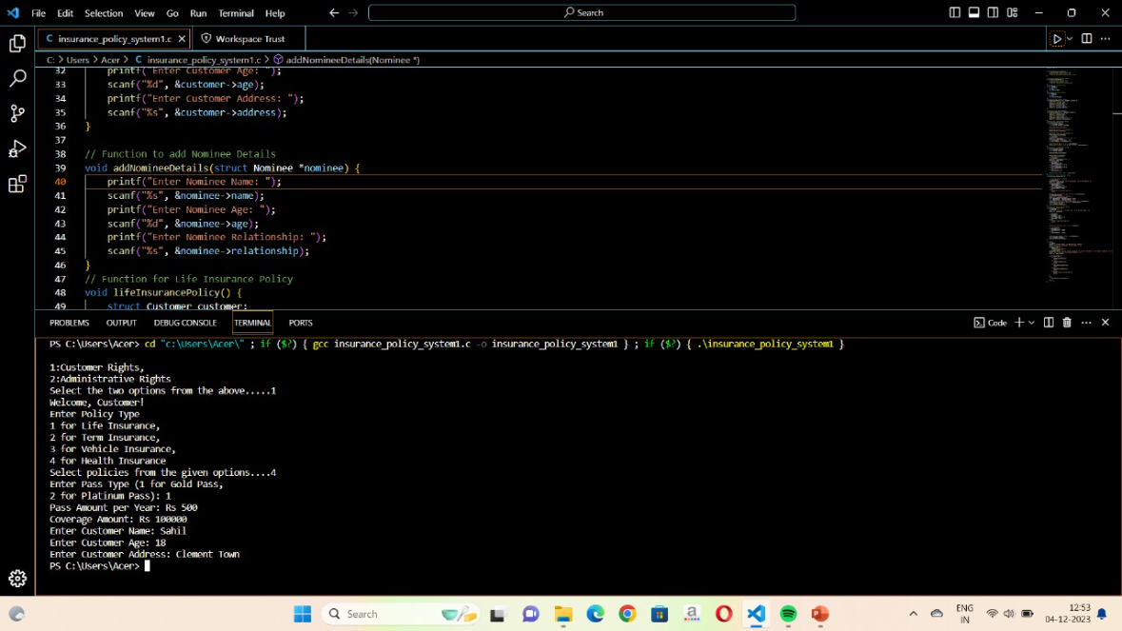

Slide 12
Customer and Nominee Details
The program uses structures to store customer and nominee details. The Customer structure contains fields for the customer's name, age, and address. The Nominee structure contains fields for the nominee's name, age, and relationship to the customer.
addCustomerDetails()-Prompts the user to enter the customer's name, age, and address, and stores the values in the Customer structure.
addNomineeDetails()-Prompts the user to enter the nominee's name, age, and relationship, and stores the values in the Nominee structure.

Slide 13
end

